Slide 1

Diabetes Predictions

Slide 2
The objective of this dataset study is to predict whether a patient has diabetes and to explore how cholesterol and glucose levels affect these patient.
Firstly, it's important to mention that individuals with diabetes often experience abnormal glucose levels, either too high (hyperglycemia) or too low (hypoglycemia). Glucose levels can provide valuable insights into a person's metabolic health, as elevated levels may indicate insulin resistance or impaired glucose regulation.
Regarding cholesterol, we typically measure two types: high-density lipoprotein (HDL) cholesterol, often referred to as "good" cholesterol, and low-density lipoprotein (LDL) cholesterol, commonly known as "bad" cholesterol
If you exclude glucose, how strong is the prediction?

Slide 3
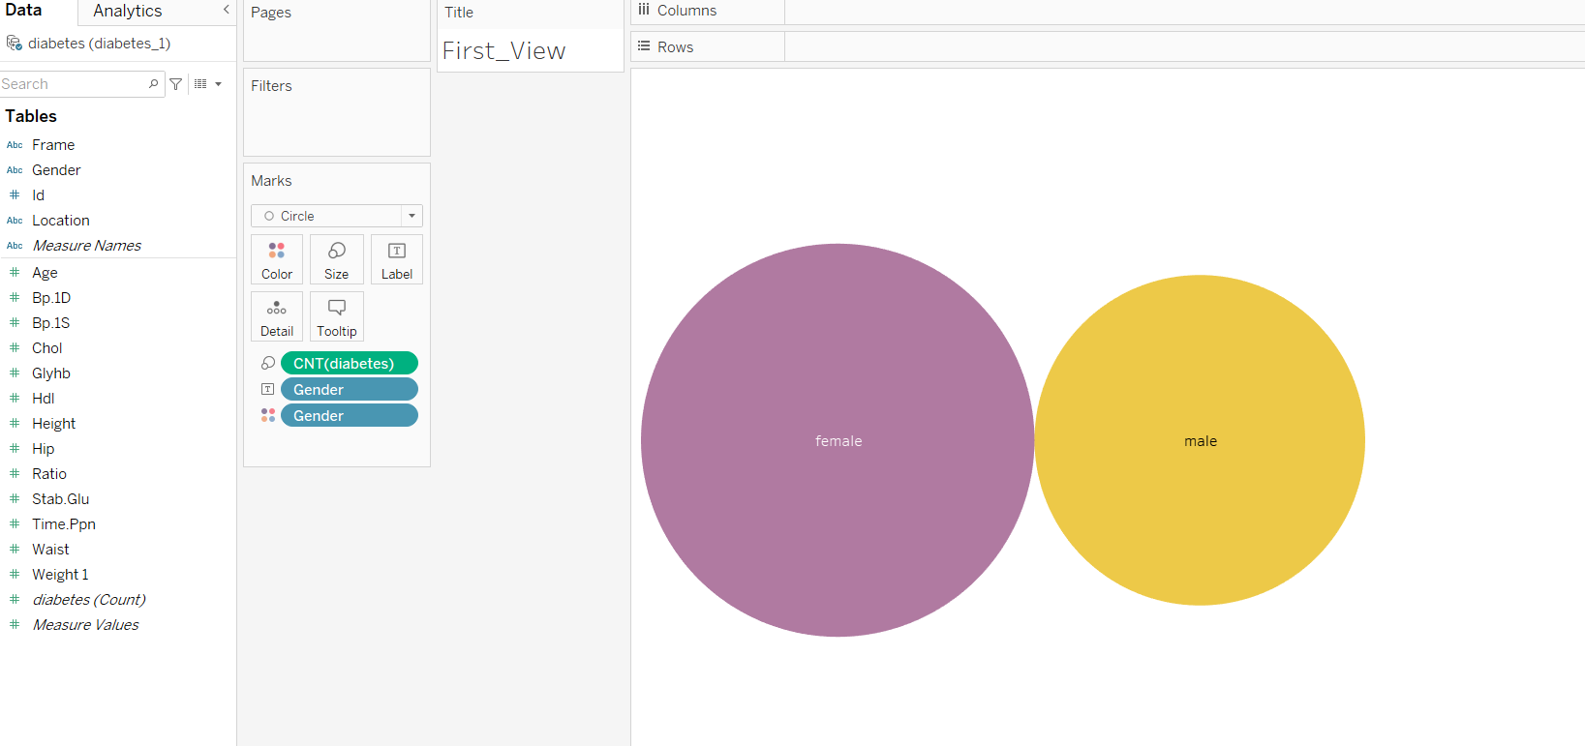
Female vs Male

Slide 4
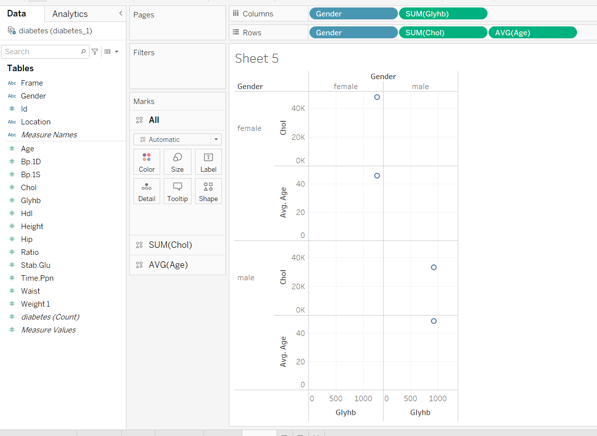
Gender

Slide 5
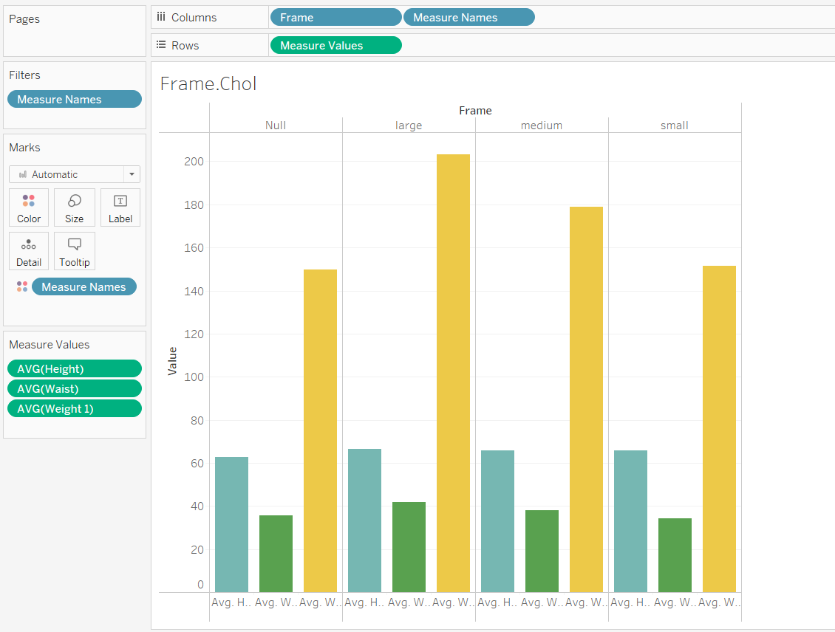
Frames

Slide 6
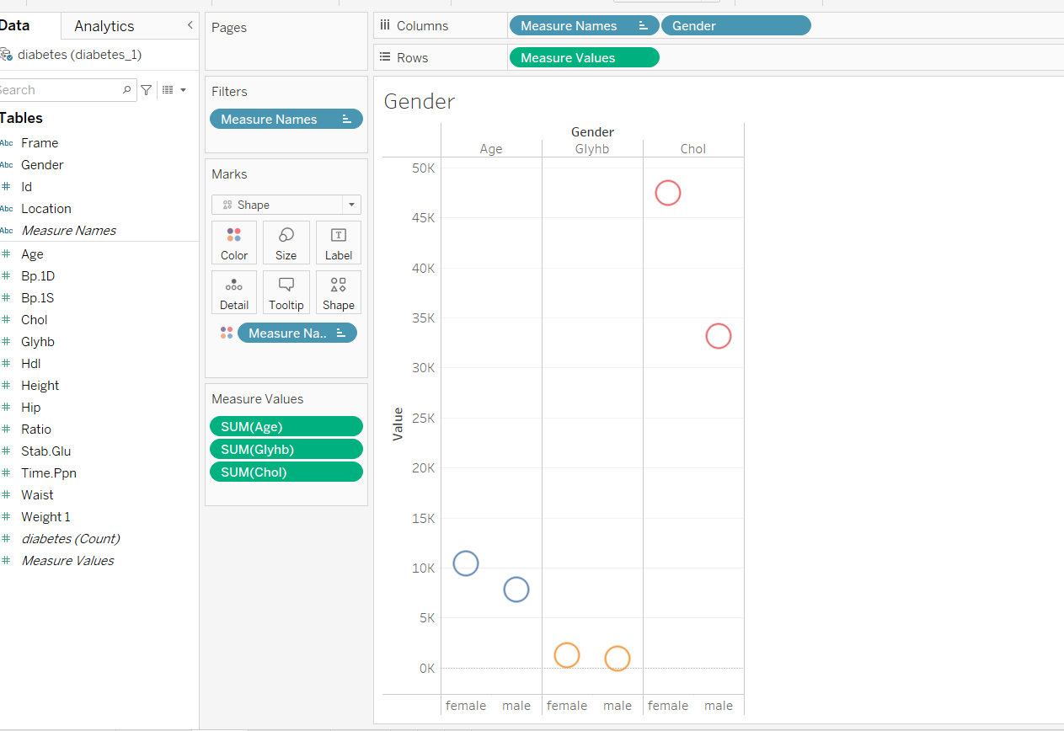
Age

Slide 7
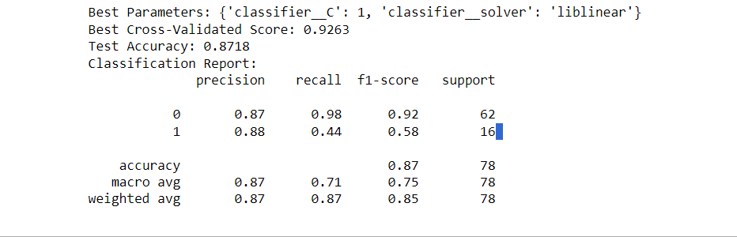
overall model performance
Best Parameters: {'classifier__C': 1, 'classifier__solver': 'liblinear'}
Best Parameters: {'classifier__C': 1, 'classifier__solver': 'liblinear'}

Slide 8

Thank you for your time

